Slide 1
HEALTHCARE DATA ANALYSIS AND VISUALIZATION
PRESENTED BY:ODERANTI AMINAT

Slide 2
INTRODUCTION
Background
Healthcare organizations generate large volumes of patient and operational data.
Analyzing healthcare data can reveal patterns that may be difficult to identify manually.
Data visualization makes these insights easier to understand.
This project uses data analytics and visualization to transform healthcare data into meaningful insights that can support informed decision-making.

Slide 3
PROBLEM STATEMENT
The key challenges addressed in this project include:
Large and difficult to analyze manually.
Inconsistent or unstructured.
Difficult to interpret without visualization.
Challenging to use for identifying patient and billing patterns.

Slide 4
AIM &OBJECTIVES
AIM
To analyze healthcare data and develop an interactive Power BI dashboard for generating meaningful insights into patient demographics, medical conditions, billing, and hospital stay patterns.
Objectives
Examine medical conditions.
Analyze patient age groups.
Analyze billing amounts.
Examine length of hospital stay.
Identify admission patterns.
Develop an interactive Power BI dashboard.

Slide 5
DATASET,SOURCE & TOOLS
Dataset:
Healthcare Patient Dataset
Data Source:
Kaggle-Healthcare Dataset
Tools used:
Microsoft Excel : initial data inspection and Presentation
Power query : Data cleaning and Transformation
Power BI : Data modelling, analysis and visualization
DAX : Measure and calculations

Slide 6
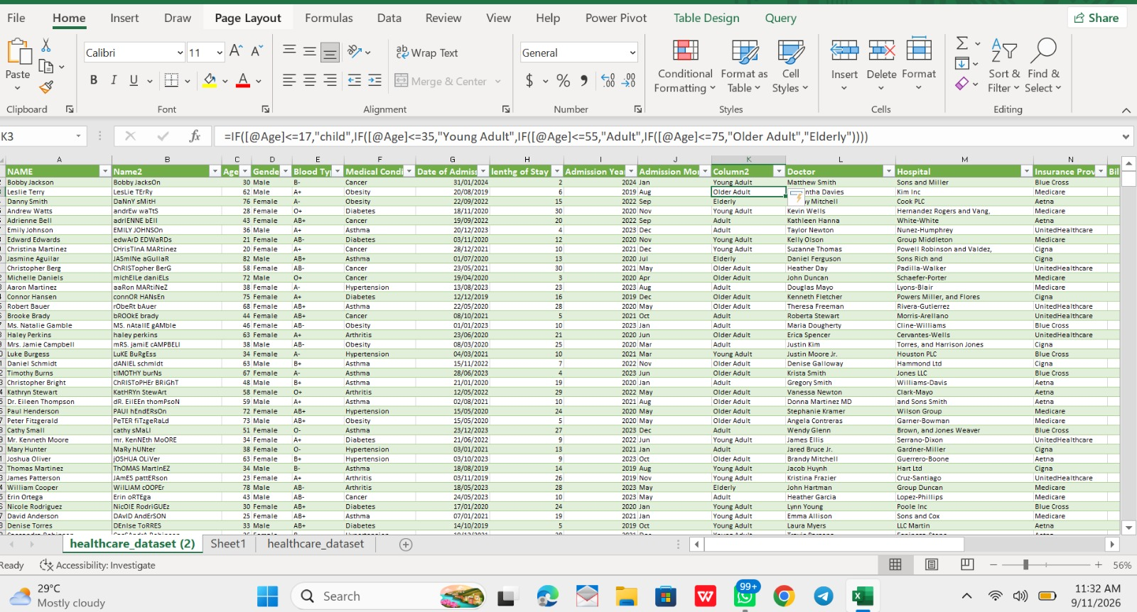
DATA CLEANING &TRANSFORMATION
Data Presentation Activities:
Remove/Handle inconsistencies, Standardized patient names using proper case Created Age Group categories Calculated Length of Stay Extracted Admission Month Checked date fields Reviewed missing or inconsistent values Prepared the dataset for analysis

Slide 7
DATA MODEL & DAX MEASURES
DAX stands for Data Analysis Expression. It is the formular language used in Power BI to create calculated measures and columns
Examples of measures:
Total Patients
Average Age
Total Billing Amount
Average Billing Amount
Average length Of Stay

Slide 8
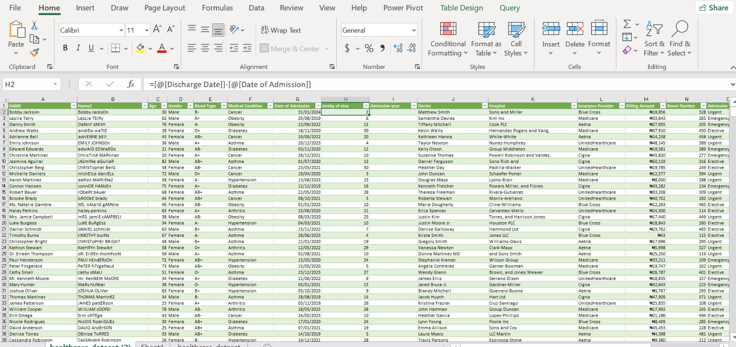
KEY PERFORMANCE INDICATORS
Healthcare KPIs
Total patients
Average Age
Total Billing Amount
Average Billing Amount
Average Length Of Stay

Slide 9
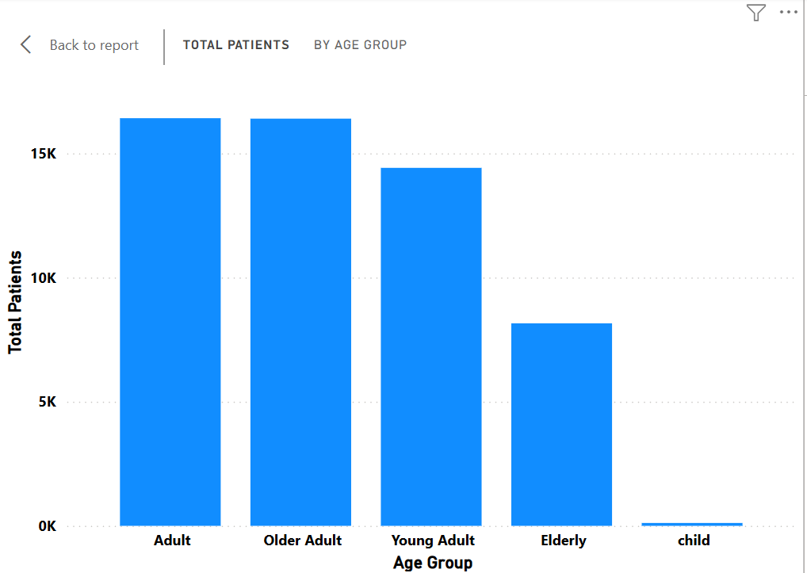
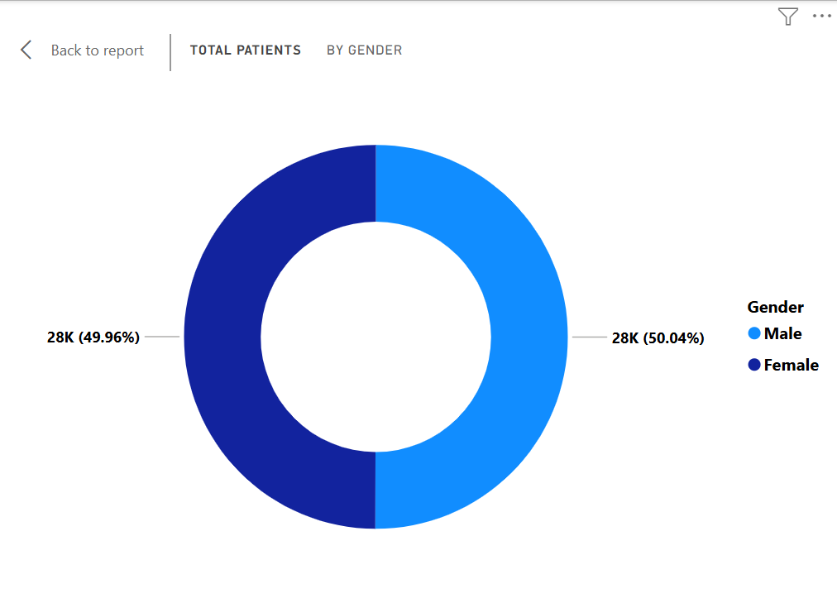
PATIENT DEMOGRAPHYIC ANALYSIS

Slide 10
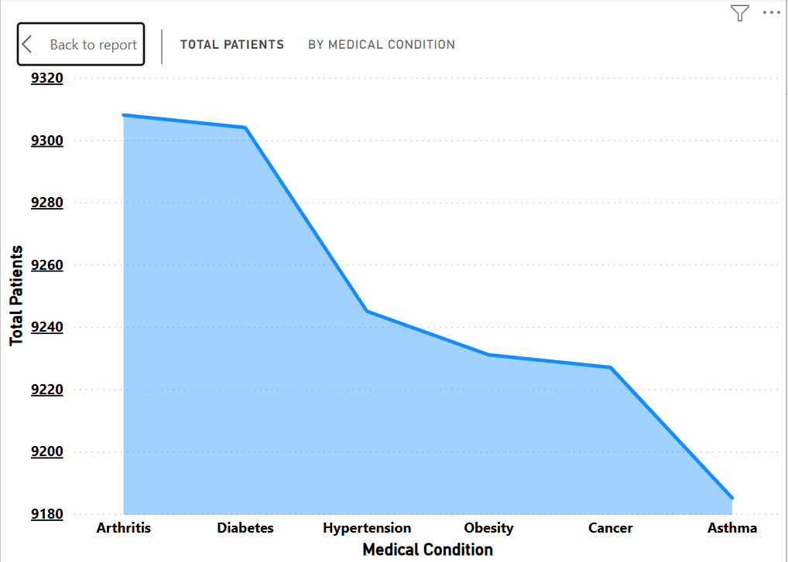
MEDICAL CONDITION ANALYSIS

Slide 11
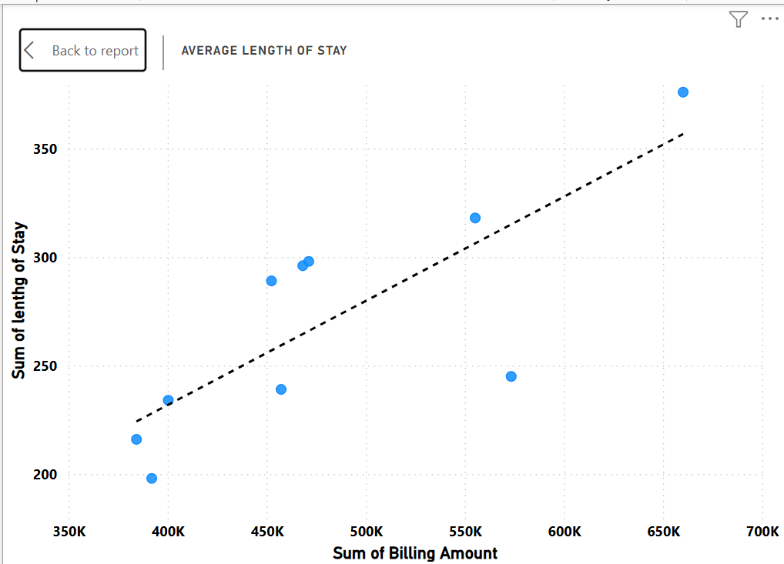
BILLING &LENGTH OF STAY ANALYSIS
Analyze:
Billing Amount
Length Of Stay
Relationship between both variable
Any visible trend/correlation

Slide 12
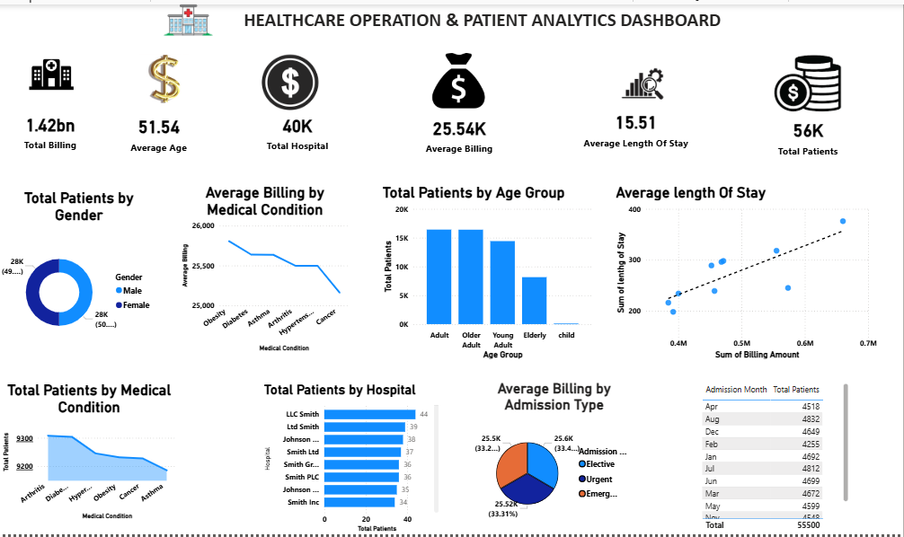

Slide 13
KEY INSIGHTS & RECOMMENDATION
Key Insights
Patients demographics shows distinct age group patterns.
Medical conditions vary across the patient population
Billing amounts differ among patients
Length of stay provides an important operation metric
Admission trends can reveals changes in healthcare utilization
Recommendations
Healthcare organizations can be patient demographics and condition patterns to support resource planning.
Billing and length of stay analysis can help monitor operational and financial patterns
Admission trends can supports staffing and capacity planning
Interactives dashboards can make healthcare information easier to monitor and communicate

Slide 14
CONCLUSION
This project demonstrates how healthcare data can be transformed into meaningful insights using data analytics
Through data cleaning, transformation, DAX calculations, visualization, and dashboard development, the project provides an interactive view of patients demographics, medical conditions, billing, length of stay, and admission trends.
THANK YOU

